Slide 1

OMNILOCK-SMART DOOR LOCKING SYSTEMS
by
2211CS050023 - Devansh Mishra
2211CS050040 - K.Thanmai Reddy
2211CS050046 - K.Shivani
Under the guidance of
Dr. G. Anand Kumar
Associate professor
Department of Internet of Things(IOT)
School of Engineering
Malla Reddy University
Hyderabad, Telangana, INDIA

Slide 2
Contents :
I Abstract
Introduction
1.1 Problem Definition & Description
1.2 Objective of the Project
1.3 Scope of the Project
2. System Analysis
2.1 Existing System
2.2 Proposed System
2.3 Software & Hardware Requirements
2.4Feasibility Study
3. Architectural Design
3.1 Modules Design
3.2 Methods and Algorithm Design
3.3 Project Architecture
4. Implementation
4.1 Coding Blocks
4.2 Execution Flow
4.3 Test Cases

Slide 3
5. Result 6. Conclusion & Future Work 6.1 Conclusion 6.2 Future Work Bibliography

Slide 4
I. Abstract:
By integrating cutting-edge biometrics with the capabilities of the Internet of Things (IoT), Omnilock enhances access control. This creative solution uses an Arduino microcontroller and ESP32 combination to produce a reliable, easy-to-use smart lock application. With its integration of touchpad entry, fingerprint authentication, and remote access through the Web server. Omnilock goes beyond traditional methods to provide unmatched security and convenience. Each feature of the system may operate independently due to its modular architecture, which guarantees optimal performance and a consistent user interface. Omnilock places security first, users can choose from secure login methods like a fingerprint sensor or a simple touchpad for convenient access. Additionally, Omnilock offers remote access, allowing you to unlock the door for specified individuals even when you are not physically present. A buzzer that sounds when entry is denied serves as a barrier to unwanted attempts. In the end, Omnilock bills itself as a safe access control system that can be used in homes and other locations, giving consumers a smooth and adaptable interface.

Slide 5
1. Introduction:
1.1 Problem Definition & Description:
Traditional methods like physical keys can be easily lost or stolen, and key management can be cumbersome. Additionally, they lack features like remote access and access control for different users.
Managing and distributing physical keys, especially for multiple individuals, can be a logistical nightmare.
Keeping track of who has which key and ensuring everyone has the necessary access can be challenging.
Resulting in inconvenience, cost of replacement, and potential security risks.
Traditional locks can be susceptible to picking or forced entry.
Traditional locks cannot be controlled remotely, making it impossible to grant or revoke access from afar.
1.2 Objective of the Project:
The primary objective of the Omnilock project is to develop an advanced Smart Door Lock System that leverages cutting-edge biometric technologies and the capabilities of the ESP32 and Arduino microcontroller to provide unparalleled security and convenience. By integrating fingerprint scanning, keypad entry, and remote access into a cohesive system, Omnilock aims to offer robust identity verification, significantly reducing the risk of unauthorized access.

Slide 6
The project seeks to address the shortcomings of traditional access control methods by delivering a comprehensive solution that is both secure and user-friendly.
1.3 Scope of the Project:
The scope of the Omnilock project encompasses the design, development, and implementation of a multi-modal authentication Smart Door Lock System. The key components and features to be included in the system are:
1. Fingerprint Sensor: A high-accuracy fingerprint sensor for quick and reliable individual identification.
2. Keypad Entry: A secure keypad interface for code-based access, offering an alternative method for users who prefer a traditional approach.
3. Remote Access Control: Web-based interface enabling users to manage access permissions and monitor activity remotely.
4. Buzzer: Audible alert system activated upon detecting unauthorized access attempts, enhancing security measures.

Slide 7
2. System Analysis:
2.1 Existing System:
2.1.1 Background & Literature Survey:
Omnilock redefines door access with biometric authentication and remote control, meeting demands for heightened security and convenience. Recent research underscores the growing interest in smart locks, particularly in biometrics and wireless communication, positioning solutions like Omnilock at the forefront of access control innovation.
2.1.2 Limitations of Existing System:
The existing system relies on physical keys, lacks remote access, and has security vulnerabilities. Omnilock solves these with advanced authentication, remote control, and enhanced security, offering a comprehensive modern door access solution.
2.2 Proposed System:
The proposed system, Omnilock, introduces biometric authentication, remote access control, and enhanced security. Advantages include heightened security, convenient remote management, and reduced reliance on physical keys. Omnilock offers a comprehensive solution for modern door access control, ensuring both security and convenience.

Slide 8
2.3 Software & Hardware Requirements:
2.3.1 Software Requirements:
Windows
Web Server
Arduino IDE
Drivers
Programming Language
Security Libraries
2.3.2 Hardware Requirements:
Laptop with 8GB RAM
Fingerprint scanner-r307s
Keypad
Buzzer
ESP 32
Arduino Uno
USB Cables
LCD Display
Jumper Wires
Servo motor
Breadboard

Slide 9
2.4 Feasibility Study:
2.4.1 Technical Feasibility:
Omnilock's technical feasibility is evident in its integration of proven technologies like fingerprint sensors and the ESP32CAM module, enabling remote access via mobile devices. Testing and validation procedures ensure reliability and security, affirming its technical viability.
2.4.2 Robustness & Reliability:
Omnilock guarantees reliability with stable performance, thorough error handling, and strong security measures. Rigorous testing and user feedback improve dependability, while regular updates maintain long-term reliability.
2.4.3 Economic Feasibility:
Omnilock's economic feasibility lies in its cost-effectiveness, competitive pricing, and scalability. With growing market demand for smart security solutions, it offers a promising return on investment for homeowners and businesses alike.

Slide 10
3. Architectural Design:
3.1 Modules Design
3.1.1 User Interface Module:
Responsible for providing an interface for users to interact with the system.
Includes functionalities such as user authentication, access request submission, and viewing system status.
Designed with a user-friendly interface for ease of use and accessibility.
3.1.2 Access Controller Module:
Manages access requests from users and coordinates the authentication process.
Acts as an intermediary between the user interface and the security system.
Responsible for initiating the authentication process and handling access control decisions based on authentication results.
3.1.3 Security System Module:
Central component responsible for authentication and access control.
Consists of sub-modules for various authentication methods such as fingerprint recognition, facial recognition, PIN authentication, and keycard authentication.
Implements access control policies based on authentication results and grants or denies access accordingly.

Slide 11
3.1.4 Authentication Module:
Handles the authentication process for verifying the identity of users.
Includes sub-modules for different authentication methods, such as biometric authentication (fingerprint and facial recognition) and traditional methods (PIN and keycard authentication).
3.1.5 Access Control Module:
Implements access control policies based on authentication results.
Determines whether users are granted or denied access to secured areas based on authentication outcomes.
Interfaces with the security system to enforce access control decisions and manage access permissions.
3.1.6 Logging & Notification Module:
Responsible for logging system events and generating notifications/alerts.
Records access control activities, authentication attempts, and system errors for audit and monitoring purposes.
Notifies administrators or users about security-related events, such as unauthorized access attempts or system malfunctions.

Slide 12
3.2 Methods and Algorithm Design:
3.2.1 PIN Authentication Method:
Omnilock provides a familiar and user-friendly keypad for PIN entry, allowing customers to create unique PINs during setup for a fast and dependable approach to unlocking the door. The LCD displays the lock state, which adds an added layer of security. The technology allows you to customize the length of your PIN, balancing security with user convenience. If an erroneous PIN is entered, a buzzer will sound to warn potential intruders.
3.2.3 Fingerprint Authentication Method:
Omnilock has a fingerprint scanner that uses optical or capacitive sensors to collect an individual's unique biometrics. During enrollment, customers scan their fingerprints several times to generate a comprehensive blueprint for proper identification. Omnilock may additionally include liveness detecting technologies to ensure that only a real finger is used, preventing attempts to spoof the system with fake fingerprints. In the event of a failed fingerprint recognition attempt, the buzzer will sound to prevent unauthorized entry.
3.2.3 Remote Access via Web Server:
Omnilock offers the convenience of remote access via a web server, which connects to a central server and allows authorized users to lock or unlock doors through a secure web application. The interface typically displays the current lock state and allows users to send locking or unlocking instructions remotely. Secure communication protocols encrypt data and prevent unauthorized access while in remote control. In addition, the system provides notification alerts when the door is opened and closed.

Slide 13
3.2.4 Fingerprint Verification Algorithm:
The technology used in fingerprint sensors does more than just take a picture of your fingers.
The actual magic of user identification is carried out by complex algorithms that are included in these sensors.
These exclusive algorithms function directly on the sensor, guaranteeing a safe and effective procedure.
Since the sensor vendor closely guards the specifics of these algorithms, they are frequently private , because it becomes harder for potential hackers to exploit the underlying workings of the algorithms, this strategy maintains security.
These sensor-specific algorithms also take advantage of the hardware's capabilities to optimize processing times and power consumption.
The sensor's fingerprint verification algorithms serve as the gatekeepers, carefully examining each characteristic of your fingerprint to provide safe and practical user identification.

Slide 14
3.2.4 String Comparison Algorithm:
PIN code protection is just one more way that Omnilock puts the security of its users first.
An important vulnerability would be a straightforward string comparison between the entered PIN and a stored PIN code.
A hacker might simply open the door if they managed to get the stored PIN codes Omnilock uses hashing functions to solve this issue. These cryptographic functions create a unique, fixed-length string of characters termed a hash using the user's PIN code as input.
The original PIN is securely represented by this hash. It's crucial to remember that the hashing function is one-way; the original PIN code cannot be recovered by mathematically reversing the hash.

Slide 15
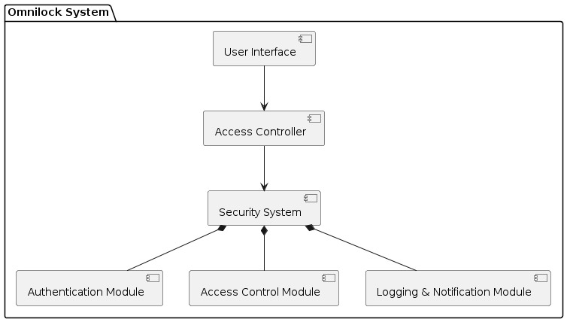
3.3 Project Architecture:
3.3.1 Architecture Diagram:
System Overview: Omnilock is a security system designed for access control, ensuring secure entry to facilities through advanced authentication methods.
Component Breakdown:
User Interface: Allows users to interact with the system.
Access Controller: Manages access requests and coordinates with the Security System.
Security System: Central component responsible for authentication and access control.
Authentication Module: Handles biometric and PIN authentication.
Access Control Module: Implements access policies based on authentication results.

Slide 16
Communication Flow: Requests for access from users are processed through the Access Controller, which interacts with the Security System for authentication and access control.
Scalability and Integration: Omnilock's modular architecture allows for scalability and integration with other security systems, accommodating various environments and security needs.
Benefits: The architectural design of Omnilock ensures enhanced security, user convenience, and ease of management, making it a robust solution for access control requirements.

Slide 17
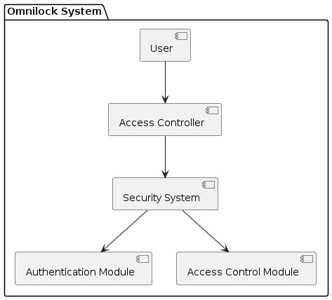
3.3.2 Data Flow Diagram:
Data Flow Visualization: The DFD provides a visual representation of how data flows within the Omnilock system, showing inputs, outputs, and processes involved in access control.
Component Interaction: It illustrates how different components of Omnilock, such as the User, Access Controller, and Security System, interact by exchanging data during the access control process.
Data Transformation: The DFD highlights how data is transformed as it moves through the system, such as user access requests being processed and authenticated by the Security System.
Boundary Identification: It helps identify the boundaries of the system by illustrating external entities (e.g., users) interacting with internal components (e.g., Access Controller and Security System).
System Functionality: By visualizing the flow of data between components, the DFD provides insight into the functionality of Omnilock, emphasizing its role in ensuring secure access control for various environments.

Slide 18
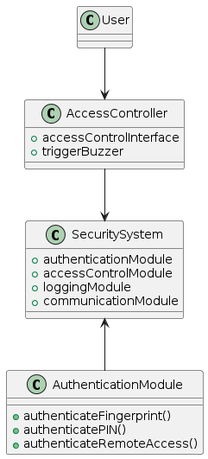
3.2.3 Class Diagram:
Structural Representation: The Class Diagram provides a structural representation of the Omnilock system, illustrating the classes (components) and their relationships.
Component Identification: It identifies key components of Omnilock, such as the User, Access Controller, Security System, and Authentication Module, along with their attributes and methods.
Relationships: The Class Diagram depicts relationships between components, such as associations, dependencies, and composition, highlighting how different parts of the system interact.
Abstraction of System: By abstracting complex system architecture into manageable components and relationships, the Class Diagram facilitates understanding and communication among stakeholders.
Design Documentation: It serves as a valuable documentation tool for system design, aiding in development, maintenance, and communication of design decisions among developers and stakeholders.

Slide 19
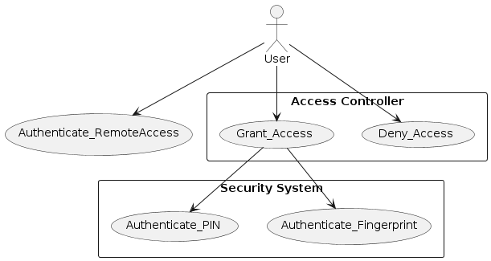
3.2.4 Use Case Diagram:
Functional Overview: The Use Case Diagram provides a functional overview of the Omnilock system, showcasing the interactions between external actors (users) and the system.
User Actions: It identifies the actions or functionalities that users can perform within the system, such as requesting access, authentication, and receiving access grants.
System Components: The Use Case Diagram highlights the major system components or actors involved in the use cases, such as the User, Access Controller, and Security System.
Interaction Flow: It illustrates the flow of interactions between users and the system, showcasing how users initiate actions and receive responses from the system.

Slide 20
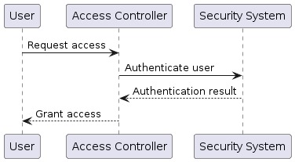
3.2.5 Sequence Diagram:
Interaction Visualization: The Sequence Diagram provides a visual representation of the interactions between different components of the Omnilock system, illustrating the flow of messages and actions over time.
Behavioral Understanding: It helps in understanding the dynamic behavior of the system by showing the sequence of steps and communication exchanges between actors and system components during specific scenarios, such as the authentication process.

Slide 21
3.2.5 Sequence Diagram:
Temporal Ordering: The Sequence Diagram depicts the temporal ordering of messages exchanged between actors and system components, providing insights into the chronological flow of interactions.
Detailed Communication: It offers a detailed view of the communication between different components, including the types of messages exchanged and the sequence of method invocations.
Error Handling: The Sequence Diagram can illustrate error handling and exception scenarios, showing how the system responds to unexpected events or errors during the execution of a sequence of actions.
Collaboration Visualization: It visualizes the collaboration between actors and objects, helping stakeholders understand how different parts of the system work together to achieve specific tasks or objectives.
Design Validation: Sequence Diagrams can be used to validate the design of the system by ensuring that the sequence of interactions aligns with the expected behavior and requirements of the system.

Slide 22
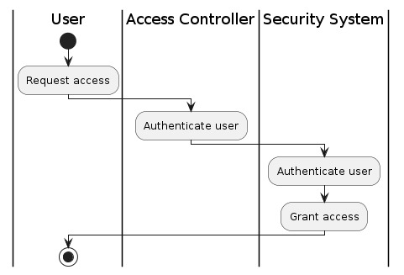
3.2.6 Activity Diagram:

Slide 23
3.2.6 Activity Diagram:
Process Visualization: The Activity Diagram provides a visual representation of the workflow or processes involved in the access control system of Omnilock, showcasing the sequence of activities and decision points.
Activity Identification: It identifies the various activities or tasks performed within the system, such as user access requests, authentication processes, and access grants.
Control Flow: The Activity Diagram illustrates the control flow between activities, including decision points, branching, and parallel activities, helping stakeholders understand the logical flow of operations.
Concurrency and Synchronization: It can depict concurrent activities and synchronization points within the system, highlighting how multiple tasks can be performed simultaneously or synchronized at specific points.
User Interaction: The Activity Diagram shows the interaction between users and the system, illustrating how users initiate actions and navigate through different activities to accomplish specific goals, such as gaining access to secured areas.

Slide 24
4. Implementation & Testing
4.1 Coding Blocks:
4.1.1 Servo Motor:
void ServoOpen(Servo s) {
Serial.println("Opening servo...");
for (int pos = s.read(); pos <= servoMax; pos += 1) {
s.write(pos);
Serial.print("Servo position: ");
Serial.println(pos);
delay(15);
}
}
void ServoClose(Servo s) {
Serial.println("Closing servo...");
for (int pos = s.read(); pos >= servoMin; pos -= 1) {
s.write(pos);
Serial.print("Servo position: ");
Serial.println(pos);
delay(15);
}
}

Slide 25
4.1.2 Fingerprint code:
#include <Adafruit_Fingerprint.h>
#include <SoftwareSerial.h>
#include <Servo.h> //Add servo library
int getFingerprintIDez();
Servo servo1; //Define servo name / object
#define servoPin 9 //Define pin number to which servo motor is connected
#define durationTime 3000 //Define the time it remains in the open position of the door lock (miliseconds)
#define servoMin 0 //Open position
#define servoMax 90 // Closed position
SoftwareSerial mySerial(12,13);
Adafruit_Fingerprint finger = Adafruit_Fingerprint(&mySerial);
void setup()
{
while (!Serial); // For Yun/Leo/Micro/Zero/...
Serial.begin(9600);
Serial.println("Adafruit finger detect test");
servo1.attach(servoPin); //Define pin number of the servo
servo1.write(servoMax); //The position of the servo at the start of the program
// set the data rate for the sensor serial port
finger.begin(57600);
if (finger.verifyPassword()) {
Serial.println("Found fingerprint sensor!");
}

Slide 26
4.1.2 Fingerprint code:
else {
Serial.println("Did not find fingerprint sensor :(");
while (1);
}
Serial.println("Waiting for valid finger...");
}
void loop() // run over and over again
{
getFingerprintIDez();
delay(50); //don't ned to run this at full speed.
}
uint8_t getFingerprintID() {
uint8_t p = finger.getImage();
switch (p) {
case FINGERPRINT_OK:
Serial.println("Image taken");
break;
case FINGERPRINT_NOFINGER:
Serial.println("No finger detected");
return p;
case FINGERPRINT_PACKETRECIEVEERR:
Serial.println("Communication error");
return p;

Slide 27
4.1.2 Fingerprint code:
case FINGERPRINT_IMAGEFAIL:
Serial.println("Imaging error");
return p;
default:
Serial.println("Unknown error");
return p;
}
// OK success!
p = finger.image2Tz();
switch (p) {
case FINGERPRINT_OK:
Serial.println("Image converted");
break;
case FINGERPRINT_IMAGEMESS:
Serial.println("Image too messy");
return p;
case FINGERPRINT_PACKETRECIEVEERR:
Serial.println("Communication error");
return p;
case FINGERPRINT_FEATUREFAIL:
Serial.println("Could not find fingerprint features");
return p;

Slide 28
4.1.2 Fingerprint code:
case FINGERPRINT_INVALIDIMAGE:
Serial.println("Could not find fingerprint features");
return p;
default:
Serial.println("Unknown error");
return p;
}
// OK converted!
p = finger.fingerFastSearch();
if (p == FINGERPRINT_OK) {
Serial.println("Found a print match!");
} else if (p == FINGERPRINT_PACKETRECIEVEERR) {
Serial.println("Communication error");
return p;
} else if (p == FINGERPRINT_NOTFOUND) {
Serial.println("Did not find a match");
return p;
} else {
Serial.println("Unknown error");
return p;
}

Slide 29
4.1.2 Fingerprint code:
// found a match!
Serial.print("Door is Open");
Serial.print("Found ID #"); Serial.print(finger.fingerID);
Serial.print(" with confidence of "); Serial.println(finger.confidence);
}
// returns -1 if failed, otherwise returns ID #
int getFingerprintIDez() {
uint8_t p = finger.getImage();
if (p != FINGERPRINT_OK) return -1;
p = finger.image2Tz();
if (p != FINGERPRINT_OK) return -1;
p = finger.fingerFastSearch();
if (p != FINGERPRINT_OK) return -1;
servo1.write(servoMin); //If the fingerprint is correct open the door lock
delay(durationTime); //Keep the lock open for the defined duration
servo1.write(servoMax); //take the lock OFF again
// found a match!
Serial.print("Found ID #"); Serial.print(finger.fingerID);
Serial.print(" with confidence of "); Serial.println(finger.confidence);
return finger.fingerID;
}

Slide 30
4.1.3 Keypad Code:
#include <Keypad.h> // the library for the 4x4 keypad
#include <LiquidCrystal_I2C.h> // the library for the i2c 1602 lcd
#include <Servo.h> // the library to control the servo motor
LiquidCrystal_I2C lcd(0x20,16,2); // gets the lcd
Servo servo;
#define Password_Length 5 // the length of the password, if the password is 4 digits long set this to 5
int Position = 0; // position of the servo
char Particular[Password_Length]; // the password length
char Specific[Password_Length] = "1234"; // the password which is called specific in the code, change this to anything you want with the numbers 0-9 and the letters A-D
byte Particular_Count = 0, Specific_Count = 0; // counts the amount of digits and and checks to see if the password is correct
char Key;
const byte ROWS = 4; // the amount of rows on the keypad
const byte COLS = 4; // the amount of columns on the keypad
char keys[ROWS][COLS] = { // sets the rowns and columns
// sets the keypad digits
{'1','2','3','A'},
{'4','5','6','B'},
{'7','8','9','C'},

Slide 31
4.1.3 Keypad Code:
{'*','0','#','D'}
};
bool SmartDoor = true; // the servo
// the pins to plug the keypad into
byte rowPins[ROWS] = {2, 3, 4, 5};
byte colPins[COLS] = {6, 8, 9, 10};
Keypad myKeypad( makeKeymap(keys), rowPins, colPins, ROWS, COLS); // gets the data from the keypad
// locked charcater
byte Locked[8] = {
B01110,
B10001,
B10001,
B11111,
B11011,
B11011,
B11011,
B11111
};
// open character

Slide 32
4.1.3 Keypad Code:
byte Opened[8] = {
B01110,
B00001,
B00001,
B11111,
B11011,
B11011,
B11011,
B11111
};
void setup()
{
servo.attach(11); // attaches the servo to pin 10
ServoClose(); // closes the servo when you say this function
lcd.init(); // initializes the lcd
lcd.backlight(); // turns on the backlight
lcd.setCursor(0,0); // sets the cursor on the lcd
lcd.print("Vector X"); // prints the text/charater
lcd.setCursor(0,1); // sets the cursor on the lcd
lcd.print("Arduino Lock!!!"); // prints text
delay(4000); // waits 4 seconds
lcd.clear(); // clears the lcd diplay
}

Slide 33
void loop()
{
if (SmartDoor == 0) // opens the smart door
{
Key = myKeypad.getKey(); // the word key = myKeypad which gets the value
if (Key == '#') // when the '#' key is pressed
{
lcd.clear(); // clears the lcd diplay
ServoClose(); // closes the servo motor
lcd.setCursor(2,0); // sets the cursor on the lcd
lcd.print("Door Closed"); // prints the text to the lcd
lcd.createChar(0, Locked); // prints the locked character
lcd.setCursor(14,0); // sets the cursor on the lcd
lcd.write(0); // prints the first character when you are on the door closed page
delay(3000); // waits 3 seconds
SmartDoor = 1; // closes the door
}
}
else Open(); // keeps the door open
}

Slide 34
void clearData() // clears the data
{
while (Particular_Count != 0) // counts the digits pressed
{
Particular[Particular_Count--] = 0; // counts how many digits
}
return; // returns the data
}
void ServoOpen() // opens the servo
{
for (Position = 180; Position >= 0; Position -= 5) { // moves from 0 to 180 degrees
servo.write(Position); // moves to the postion
delay(15); // waits 15 milliseconds
}
}
void ServoClose() // closes the servo
{
for (Position = 0; Position <= 90; Position += 5) { // moves from position 0 to 180 degrees
servo.write(Position); // moves to the position
delay(15); // waits 15 milliseconds
}
}

Slide 35
void Open() // function declarations
{
lcd.setCursor(1,0); // sets the cursor on the lcd
lcd.print("Enter Password:"); // prints the text
Key = myKeypad.getKey(); // gets the keys you press from the keypad
if (Key)
{
Particular[Particular_Count] = Key;
lcd.setCursor(Particular_Count, 1); // sets the cursor on the lcd
lcd.print("*"); // prints '*' instead of the password
Particular_Count++; // counts the length of the password
}
if (Particular_Count == Password_Length - 1) // gets the length of the password
{
if (!strcmp(Particular, Specific)) // counts the length and checks to see if the password is correct
{
lcd.clear();
ServoOpen(); // moves the servo 180 degrees
lcd.setCursor(2,0); // sets the cursor on the lcd
lcd.print("Door Opened");
lcd.createChar(1, Opened);
lcd.setCursor(14,0); // sets the cursor on the lcd
lcd.write(1);
lcd.setCursor(0,1); // sets the cursor on the lcd

Slide 36
lcd.print("Press # to Close");
SmartDoor = 0;
}
else
{
lcd.clear();
lcd.setCursor(0,0); // sets the cursor on the lcd
lcd.print("Wrong Password"); // prints the text/character
lcd.setCursor(0,1);
lcd.print("Try Again In");
lcd.setCursor(13,1);
lcd.print("10");
delay(1000);
lcd.setCursor(13,1);
lcd.print("09");
delay(1000);
lcd.setCursor(13,1);
lcd.print("08");
delay(1000);
lcd.setCursor(13,1);
lcd.print("07");
delay(1000);
lcd.setCursor(13,1);
lcd.print("06");
delay(1000);
lcd.setCursor(13,1);

Slide 37
lcd.print("05");
delay(1000);
lcd.setCursor(13,1);
lcd.print("04");
delay(1000);
lcd.setCursor(13,1);
lcd.print("03");
delay(1000);
lcd.setCursor(13,1);
lcd.print("02");
delay(1000);
lcd.setCursor(13,1);
lcd.print("01");
delay(1000);
lcd.setCursor(13,1);
lcd.print("00");
delay(1000);
lcd.clear();
SmartDoor = 1; // closes the smart door
}
clearData(); // clears the data
}
}

Slide 38
4.1.4 Remote Access
#include <WiFi.h>
#include <ESP32Servo.h>
Servo myservo; // Create servo object to control a servo
// GPIO the servo is attached to
static const int servoPin = 13;
// Replace with your network credentials
const char* ssid = "Laptop";
const char* password = "#dev11oc04";
// Set web server port number to 80
WiFiServer server(80);
// Variable to store the HTTP request
String header;
// Decode HTTP GET value
int servoPosition = 0;
// Current time
unsigned long currentTime = millis();
// Previous time
unsigned long previousTime = 0;
// Define timeout time in milliseconds (example: 2000ms = 2s)
const long timeoutTime = 2000;

Slide 39
// Decode HTTP GET value
int servoPosition = 0;
// Current time
unsigned long currentTime = millis();
// Previous time
unsigned long previousTime = 0;
// Define timeout time in milliseconds (example: 2000ms = 2s)
const long timeoutTime = 2000;
// Previous time
unsigned long previousTime = 0;
// Define timeout time in milliseconds (example: 2000ms = 2s)
const long timeoutTime = 2000;
void setup() {
Serial.begin(115200); // Set baud rate to 115200 for the serial monitor
myservo.attach(servoPin); // Attaches the servo on the servoPin to the servo object
// Connect to Wi-Fi network with SSID and password
Serial.print("Connecting to ");
Serial.println(ssid);
WiFi.begin(ssid, password);

Slide 40
// Improved connection feedback
unsigned long startTime = millis();
while (WiFi.status() != WL_CONNECTED) {
delay(500);
Serial.print(".");
// Optional: You can add a timeout for connection attempts
if (millis() - startTime > 10000) { // 10 seconds timeout
Serial.println("\nFailed to connect to WiFi, restarting...");
ESP.restart(); // Restart the ESP32
}
}
// Print local IP address and start web server
Serial.println("");
Serial.println("WiFi connected.");
Serial.print("IP address: ");
Serial.println(WiFi.localIP());
server.begin();
}
void loop() {
WiFiClient client = server.available(); // Listen for incoming clients
if (client) { // If a new client connects,
currentTime = millis();
previousTime = currentTime;
Serial.println("New Client."); // Print a message out in the serial port
String currentLine = ""; // Make a String to hold incoming data from the client

Slide 41
while (client.connected() && currentTime - previousTime <= timeoutTime) { // Loop while the client's connected
currentTime = millis();
if (client.available()) { // If there's bytes to read from the client,
char c = client.read(); // Read a byte, then
Serial.write(c); // Print it out the serial monitor
header += c;
if (c == '\n') { // If the byte is a newline character
// If the current line is blank, you got two newline characters in a row.
// That's the end of the client HTTP request, so send a response:
if (currentLine.length() == 0) {
// Parse GET request before sending the response
bool servoActionTaken = false;
String action;
if (header.indexOf("GET /open") >= 0) {
servoPosition = 0; // Change to the closed position
myservo.write(servoPosition);
Serial.println("Door Opened");
servoActionTaken = true;
action = "open";
}
if (header.indexOf("GET /close") >= 0) {
servoPosition = 90; // Change to the open position
myservo.write(servoPosition);
Serial.println("Door Closed");
servoActionTaken = true;
action = "close"; }

Slide 42
// HTTP headers always start with a response code (e.g. HTTP/1.1 200 OK)
// and a content-type so the client knows what's coming, then a blank line:
client.println("HTTP/1.1 200 OK");
client.println("Content-type:text/html");
client.println("Connection: close");
client.println();
// Display the HTML web page
client.println("<!DOCTYPE html><html>");
client.println("<head><meta name=\"viewport\" content=\"width=device-width, initial-scale=1\">");
client.println("<link rel=\"icon\" href=\"data:,\">");
// CSS to style the on/off buttons
client.println("<style>body { text-align: center; font-family: 'Trebuchet MS', Arial; background-color: #f7f7f7; color: #333; margin-left: auto; margin-right: auto; padding: 0 10px; }");
client.println(".button { display: inline-block; padding: 15px 25px; font-size: 24px; cursor: pointer; text-align: center; text-decoration: none; outline: none; color: #fff; background-color: #4CAF50; border: none; border-radius: 15px; box-shadow: 0 9px #999; margin: 10px; }");
client.println(".button:hover { background-color: #3e8e41 }");
client.println(".button:active { background-color: #3e8e41; box-shadow: 0 5px #666; transform: translateY(4px); }"); client.println(".button-red { background-color: #f44336; }");
client.println(".button-red:hover { background-color: #da190b; }");
client.println(".button-red:active { background-color: #da190b; box-shadow: 0 5px #666; transform: translateY(4px); }");
client.println(".container { background-color: #fff; padding: 20px; border-radius: 10px; box-shadow: 0 2px 4px rgba(0,0,0,0.1); display: inline-block; margin-top: 50px; }");

Slide 43
client.println("h1 { color: #5D6D7E; }");
client.println("</style>");
client.println("</head>");
client.println("<body>");
client.println("<div class=\"container\">");
client.println("<h1>OmniLock</h1>");
client.println("<button class=\"button\" onclick=\"sendData('open')\">Open</button>");
client.println("<button class=\"button button-red\" onclick=\"sendData('close')\">Close</button>");
client.println("</div>");
client.println("<script>");
client.println("function sendData(action) {");
client.println(" var xhttp = new XMLHttpRequest();");
client.println(" xhttp.open('GET', '/' + action, true);");
client.println(" xhttp.send();");
client.println(" if (action == 'open') { alert('Door is Opened'); }");
client.println(" if (action == 'close') { alert('Door is Closed'); }");
client.println("}");
client.println("</script>");
client.println("</body>");
client.println("</html>");
// The HTTP response ends with another blank line
client.println();
// Break out of the while loop
break;

Slide 44
} else { // If you got a newline, then clear currentLine
currentLine = "";
}
} else if (c != '\r') { // If you got anything else but a carriage return character,
currentLine += c; // Add it to the end of the currentLine
}
}
}
// Clear the header variable
header = "";
// Close the connection
client.stop();
Serial.println("Client disconnected.");
Serial.println("");
}
}

Slide 45
4.1.5 Integration of Fingerprint, Keypad, and Remote Access
#include <Adafruit_Fingerprint.h>
#include <SoftwareSerial.h>
#include <Keypad.h>
#include <Wire.h>
#include <LiquidCrystal_I2C.h>
#include <Servo.h>
#define Password_Length 5
#define servoPin 13 // Define pin number to which servo motor is connected
#define durationTime 3000 // Define the time it remains in the open position of the door lock (milliseconds)
#define servoMin 0 // Open position
#define servoMax 90 // Closed position
SoftwareSerial mySerial(9, 12);
Adafruit_Fingerprint finger = Adafruit_Fingerprint(&mySerial);
Servo servo1; // Define servo name / object
LiquidCrystal_I2C lcd(0x27, 16, 2); // Change the address to match your I2C address
char Data[Password_Length];
char Master[Password_Length] = "5555";
byte data_count = 0;
bool door = false;

Slide 46
const int buzzer = 8;
const byte ROWS = 4;
const byte COLS = 4;
char keys[ROWS][COLS] = {
{'1', '2', '3', 'A'},
{'4', '5', '6', 'B'},
{'7', '8', '9', 'C'},
{'*', '0', '#', 'D'}
};
byte rowPins[ROWS] = {7, 6, 5, 4};
byte colPins[COLS] = {3, 2, 1, 0};
Keypad customKeypad(makeKeymap(keys), rowPins, colPins, ROWS, COLS);
void setup() {
pinMode(buzzer, OUTPUT);
servo1.attach(servoPin); // Define pin number of the servo
servo1.write(servoMax); // The position of the servo at the start of the program
lcd.init(); // Initialize the I2C LCD
lcd.backlight(); // Turn on the backlight
lcd.print("Protected Door");
loading("Loading");
lcd.clear();

Slide 47
Serial.begin(9600);
Serial.println("Adafruit finger detect test");
// set the data rate for the sensor serial port
finger.begin(57600);
if (finger.verifyPassword()) {
Serial.println("Found fingerprint sensor!");
} else {
Serial.println("Did not find fingerprint sensor :(");
while (1);
}
Serial.println("Waiting for valid finger...");
}
void loop() {
if (door == true) {
char customKey = customKeypad.getKey();
if (customKey == '#') {
lcd.clear();
ServoClose();
lcd.print("Door is closed");
delay(3000);
door = false;
}
}

Slide 48
else {
char fingerprintID = getFingerprintIDez();
if (fingerprintID != -1) {
lcd.clear();
ServoOpen();
lcd.print("Door is Open");
door = true;
delay(5000);
loading("Waiting");
lcd.clear();
lcd.print("Time is up!");
lcd.print("Door is closed");
delay(1000);
ServoClose();
door = false;
} else {
Open();
}
}
}
void loading(char msg[]) {
lcd.setCursor(0, 1);
lcd.print(msg);
for (int i = 0; i < 9; i++) {
delay(1000);

Slide 49
lcd.print(".");
}
}
void clearData() {
while (data_count != 0) {
Data[data_count--] = 0;
}
return;
}
void ServoClose() {
servo1.write(servoMax); // Closed position
}
void ServoOpen() {
servo1.write(servoMin); // Open position
}
void Open() {
lcd.setCursor(0, 0);
lcd.print("Enter Password or Scan Fingerprint:");
char customKey = customKeypad.getKey();
if (customKey) {
Data[data_count] = customKey;

Slide 50
lcd.setCursor(data_count, 1);
lcd.print(Data[data_count]);
data_count++;
}
if (data_count == Password_Length - 1) {
if (!strcmp(Data, Master)) {
lcd.clear();
ServoOpen();
lcd.print(" Door is Open ");
door = true;
delay(5000);
loading("Waiting");
lcd.clear();
lcd.print(" Time is up! ");
lcd.print("Door is closed");
delay(1000);
ServoClose();
door = false;
} else {
lcd.clear();
lcd.print(" Wrong Password ");
lcd.print("Access Denied");
activateBuzzer(); // Access Denied, activate buzzer
door = false;
}
delay(1000);

Slide 51
lcd.clear();
clearData();
}
}
void activateBuzzer() {
tone(buzzer, 1000); // Activate the buzzer
delay(1000); // Buzz for 1 second
noTone(buzzer); // Stop the buzzer
}
uint8_t getFingerprintID() {
uint8_t p = finger.getImage();
switch (p) {
case FINGERPRINT_OK:
Serial.println("Image taken");
break;
case FINGERPRINT_NOFINGER:
Serial.println("No finger detected");
return p;
case FINGERPRINT_PACKETRECIEVEERR:
Serial.println("Communication error");
return p;
case FINGERPRINT_IMAGEFAIL:
Serial.println("Imaging error");
return p;
default:

Slide 52
Serial.println("Unknown error");
return p;
}
// OK success!
p = finger.image2Tz();
switch (p) {
case FINGERPRINT_OK:
Serial.println("Image converted");
break;
case FINGERPRINT_IMAGEMESS:
Serial.println("Image too messy");
return p;
case FINGERPRINT_PACKETRECIEVEERR:
Serial.println("Communication error");
return p;
case FINGERPRINT_FEATUREFAIL:
Serial.println("Could not find fingerprint features");
return p;
case FINGERPRINT_INVALIDIMAGE:
Serial.println("Could not find fingerprint features");
return p;
default:
Serial.println("Unknown error");
return p;
}
// OK converted!

Slide 53
p = finger.fingerFastSearch();
if (p == FINGERPRINT_OK) {
Serial.println("Found a print match!");
} else if (p == FINGERPRINT_PACKETRECIEVEERR) {
Serial.println("Communication error");
return p;
} else if (p == FINGERPRINT_NOTFOUND) {
Serial.println("Did not find a match");
return p;
} else {
Serial.println("Unknown error");
return p;
}
// found a match!
Serial.print("Door is Open");
Serial.print("Found ID #"); Serial.print(finger.fingerID);
Serial.print(" with confidence of "); Serial.println(finger.confidence);
}
int getFingerprintIDez() {
uint8_t p = finger.getImage();
if (p != FINGERPRINT_OK) return -1;
p = finger.image2Tz();
if (p != FINGERPRINT_OK) return -1;
p = finger.fingerFastSearch();
if (p != FINGERPRINT_OK) {

Slide 54
activateBuzzer(); // Access Denied, activate buzzer
return -1;
}
ServoOpen(); // If the fingerprint is correct open the door lock
delay(durationTime); // Keep the lock open for the defined duration
ServoClose(); // take the lock OFF again
// found a match!
Serial.print("Found ID #"); Serial.print(finger.fingerID);
Serial.print(" with confidence of "); Serial.println(finger.confidence);
return finger.fingerID;
}
#include <WiFi.h>
#include <ESP32Servo.h>
Servo myservo; // Create a servo object to control a servo
// GPIO the servo is attached to
static const int servoPin = 13;
// Replace with your network credentials
const char* ssid = "Laptop";
const char* password = "#dev11oc04";
// Set web server port number to 80
WiFiServer server(80);

Slide 55
// Variable to store the HTTP request
String header;
// Decode HTTP GET value
int servoPosition = 0;
// Current time
unsigned long currentTime = millis();
// Previous time
unsigned long previousTime = 0;
// Define timeout time in milliseconds (example: 2000ms = 2s)
const long timeoutTime = 2000;
void setup() {
Serial.begin(115200); // Set baud rate to 115200 for the serial monitor
myservo.attach(servoPin); // Attaches the servo on the servoPin to the servo object
// Connect to Wi-Fi network with SSID and password
Serial.print("Connecting to ");
Serial.println(ssid);
WiFi.begin(ssid, password);
// Improved connection feedback
unsigned long startTime = millis();
while (WiFi.status() != WL_CONNECTED) {
delay(500);

Slide 56
Serial.print(".");
// Optional: You can add a timeout for connection attempts
if (millis() - startTime > 10000) { // 10 seconds timeout
Serial.println("\nFailed to connect to WiFi, restarting...");
ESP.restart(); // Restart the ESP32
}
}
// Print local IP address and start web server
Serial.println("");
Serial.println("WiFi connected.");
Serial.print("IP address: ");
Serial.println(WiFi.localIP());
server.begin();
}
void loop() {
WiFiClient client = server.available(); // Listen for incoming clients
if (client) { // If a new client connects,
currentTime = millis();
previousTime = currentTime;
Serial.println("New Client."); // Print a message out in the serial port
String currentLine = ""; // Make a String to hold incoming data from the client
while (client.connected() && currentTime - previousTime <= timeoutTime) { // Loop while the client's connected
currentTime = millis();

Slide 57
if (client.available()) { // If there are bytes to read from the client,
char c = client.read(); // Read a byte, then
Serial.write(c); // Print it out the serial monitor
header += c;
if (c == '\n') { // If the byte is a newline character
// If the current line is blank, you got two newline characters in a row.
// That's the end of the client HTTP request, so send a response:
if (currentLine.length() == 0) {
// Parse GET request before sending the response
bool servoActionTaken = false;
String action;
if (header.indexOf("GET /open") >= 0) {
servoPosition = 0; // Change to the closed position
myservo.write(servoPosition);
Serial.println("Door Opened");
servoActionTaken = true;
action = "open";
}
if (header.indexOf("GET /close") >= 0) {
servoPosition = 90; // Change to the open position
myservo.write(servoPosition);
Serial.println("Door Closed");
servoActionTaken = true;
action = "close";
}

Slide 58
// HTTP headers always start with a response code (e.g. HTTP/1.1 200 OK)
// and a content-type so the client knows what's coming, then a blank line:
client.println("HTTP/1.1 200 OK");
client.println("Content-type:text/html");
client.println("Connection: close");
client.println();
// Display the HTML web page
client.println("<!DOCTYPE html><html>");
client.println("<head><meta name=\"viewport\" content=\"width=device-width, initial-scale=1\">");
client.println("<link rel=\"icon\" href=\"data:,\">");
// CSS to style the on/off buttons
client.println("<style>body { text-align: center; font-family: 'Trebuchet MS', Arial; background-color: #f7f7f7; color: #333; margin-left: auto; margin-right: auto; padding: 0 10px; }");
client.println(".button { display: inline-block; padding: 15px 25px; font-size: 24px; cursor: pointer; text-align: center; text-decoration: none; outline: none; color: #fff; background-color: #4CAF50; border: none; border-radius: 15px; box-shadow: 0 9px #999; margin: 10px; }");
client.println(".button:hover { background-color: #3e8e41 }");
client.println(".button:active { background-color: #3e8e41; box-shadow: 0 5px #666; transform: translateY(4px); }");
client.println(".button-red { background-color: #f44336; }");
client.println(".button-red:hover { background-color: #da190b; }");
client.println(".button-red:active { background-color: #da190b; box-shadow: 0 5px #666; transform: translateY(4px); }");
client.println(".container { background-color: #fff; padding: 20px; border-radius: 10px; box-shadow: 0 2px 4px rgba(0,0,0,0.1); display: inline-block; margin-top: 50px; }");

Slide 59
client.println("h1 { color: #5D6D7E; }");
client.println("</style>");
client.println("</head>");
client.println("<body>");
client.println("<div class=\"container\">");
client.println("<h1>OmniLock</h1>");
client.println("<button class=\"button\" onclick=\"sendData('open')\">Open</button>");
client.println("<button class=\"button button-red\" onclick=\"sendData('close')\">Close</button>");
client.println("</div>");
client.println("<script>");
client.println("function sendData(action) {");
client.println(" var xhttp = new XMLHttpRequest();");
client.println(" xhttp.open('GET', '/' + action, true);");
client.println(" xhttp.send();");
client.println(" if (action == 'open') { alert('Door is Opened'); }");
client.println(" if (action == 'close') { alert('Door is Closed'); }");
client.println("}");
client.println("</script>");
client.println("</body>");
client.println("</html>");
// The HTTP response ends with another blank line
client.println();
// Break out of the while loop
break;

Slide 60
} else { // If you got a newline, then clear currentLine
currentLine = "";
}
} else if (c != '\r') { // If you got anything else but a carriage return character,
currentLine += c; // Add it to the end of the currentLine
}
}
}
// Clear the header variable
header = "";
// Close the connection
client.stop();
Serial.println("Client disconnected.");
Serial.println("");
}
}

Slide 62
4.2 Execution Flow:
4.2.1 User Interaction:
The execution flow begins when a user approaches a secured area and interacts with the Omnilock system, typically through a user interface such as a touchscreen or keypad.
4.2.2 Access Request:
The user initiates the access request by providing their credentials, which may include biometric data (e.g., fingerprint), or a personal identification number (PIN)
4.2.3 Input Processing:
Omnilock's access controller receives and processes the input provided by the user, which may involve capturing biometric data, validating PINs, or decoding keycard information.
4.2.4 Authentication:
The system authenticates the user's credentials using the appropriate authentication method(s) configured for the access control system.
Biometric authentication involves matching the captured biometric data with stored templates or reference data.

Slide 63
PIN authentication verifies the correctness of the entered PIN against the stored user credentials.
Keycard authentication validates the data stored on the keycard and verifies its authenticity.
4.2.5 Access Control Decision:
Based on the authentication results, the system makes an access control decision to either grant or deny access to the secured area.
If the user's credentials are successfully authenticated, access is granted, and the user is allowed entry.
If authentication fails or if the user's credentials do not meet the access control criteria, access is denied, and the user is prevented from entering the secured area.
4.2.6 Logging and Notification:
The system logs the access control event, recording details such as the user's identity, the outcome of the access control decision, and the timestamp of the event.
Notifications or alerts may be generated to inform administrators or security personnel about access control events, especially in the case of unauthorized access attempts or security breaches.

Slide 64
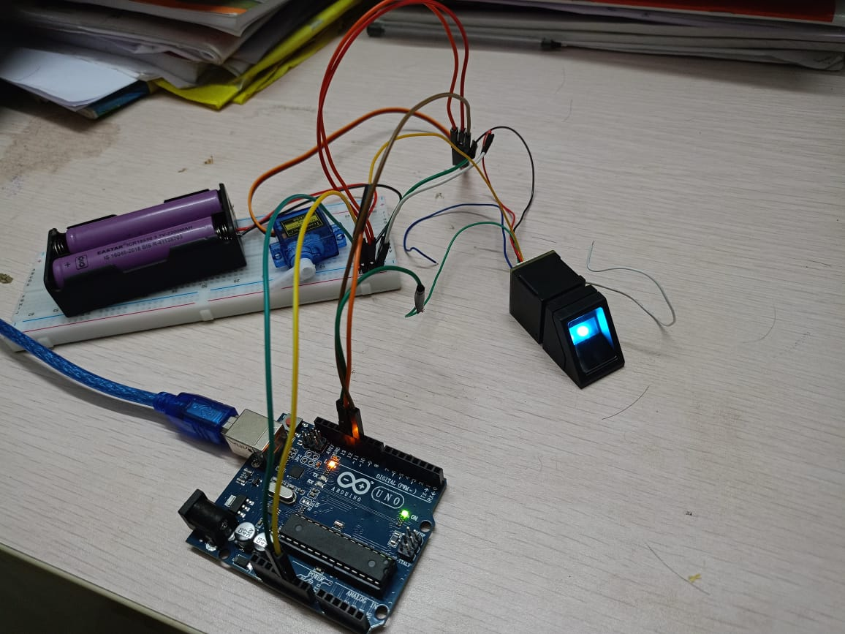
4.3 Test Cases:
4.3.1 Test Case1 : Fingerprint Image

Slide 65
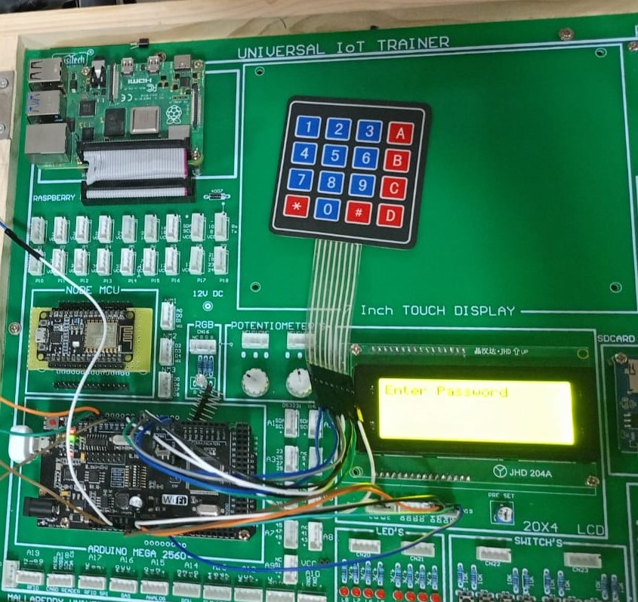
4.3.2 Test Case 2: Keypad Image

Slide 66
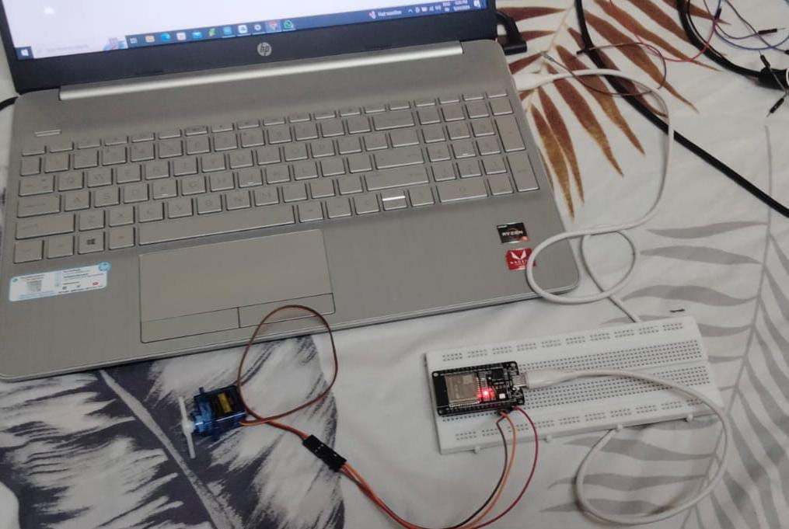
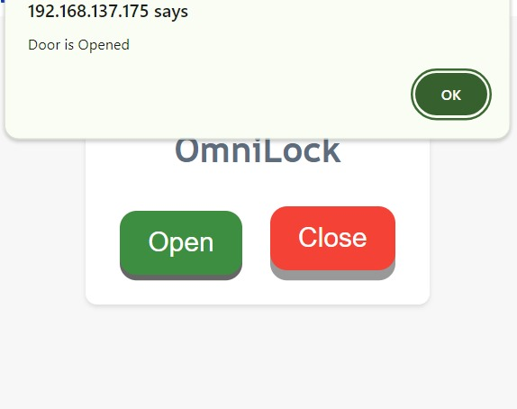
4.3.2 Test Case 3: Remote Access

Slide 67
6. Conclusion & Future Work
6.1 Conclusions
By overcoming the drawbacks of conventional keys and single-factor authentication, Omnilock transforms access control. With its multi-modal approach, customers can select their favorite technique, be it a fingerprint scanner or secure keypad. Compared to readily misplaced, stolen, or duplicated keys or RFID cards that are susceptible to interception, this greatly improves security. Another level of comfort comes with the possibility of remote access control provided through the web server. Omnilock markets itself as a user-friendly, flexible, and safe access control system. With the use of potent microcontrollers, state-of-the-art biometrics, and the possibility of smart home integration, Omnilock users are in a new era of smart and practical door locks for homes and other locations.
6.2 Future Work
Encouraging possibilities exist for enhanced security and user-friendliness in the future. Visualize a scenario where high-security regions require access to both a PIN code and a fingerprint scan as part of multi-factor authentication. When you get closer, geofencing might open the door for you, and time-based access might only allow certain users in during particular times. Voice authentication may even be made available as a convenient hands-free option.

Slide 68
Bibliography
[1] Anu and Bhatia, “A smart door access system using fingerprint biometric system” International Journal of Medical Engineering and Informatics www.inderscience.com Volume No.06, Issue No.03,7 July 2014.
[2] Arpita Mishra, Siddharth Sharma, Sachin Dubey, S. K. Dubey, “PASSWORD BASED SECURITY LOCK SYSTEM” International Journal of Advanced Technology in Engineering and Science www.ijates.com Volume No.02, Issue No. 05, May 2014 ISSN (online): 2348 – 7550.
[3] Dr. M. SivaSangari, Dhivakar. E, Gowthaam. K, “Secret Knock Detecting Door Lock” Annals of R.S.C.B., ISSN:1583-6258, Vol. 25, Issue 5, 2021, Pages. 406-410 Received 15 April 2021; Accepted 05 May 2021.
[4] Adarsh V Patil, Sreevarsha Prakash, Akshay S, Mahadeva Swamy, Chandan B Patgar, Sharath Kumar A J, “Android Based Smart Door Locking System” International Journal of Engineering Research & Technology (IJERT) ISSN: 2278-0181 Published by, www.ijert.org NCESC - 2018 Conference Proceedings.
[5] K. Rajesh, ASST. PROFESSOR, B. Venkata Rao, P. AV. S. K. Chaitanya, A. Ruchitha Reddy, “SMART DOOR UNLOCK SYSTEM USING FINGERPRINT” Pramana Research Journal Volume 9, Issue 3, 2019 ISSN NO: 2249-2976.

Slide 69
[6] A.Vadakkan, A.Babu.V.K and C.Pappachan, "DOOR LOCKING USING KEYPAD AND ARDUINO," International Research Journal of Modernization in Engineering Technology and Science, vol. 3, no. 11, p. 783, 2021.
[7] Park, Yong Tae, Pranesh Sthapit, and Jae-Young Pyun. "Smart digital door lock for the home automation." In TENCON 2009-2009 IEEE Region 10 Conference, pp. 1-6. IEEE, 2009.
[8] Kassem, Abdallah, Sami El Murr, Georges Jamous, Elie Saad, and Marybelle Geagea. "A smart lock system using Wi-Fi security." In Advances in Computational Tools for Engineering Applications (ACTEA), 2016 3rd International Conference on, pp. 222-225. IEEE, 2016.
[9] Manurung, M. J., Poningsih, P., Andani, S. R., Safii, M., & Irawan, I. (2021). “Door Security Design Using Fingerprint and Buzzer Alarm Based on Arduino”. Journal of Computer Networks, Architecture and High Performance Computing, 3(1), 42-51.
[10] LiaKamelia, AlfinNoorhassan S.R, MadaSanjaya and W.S., Edi Mulyana, “DOOR-AUTOMATION SYSTEM USING BLUETOOTH-BASED ANDROID FOR MOBILE PHONE” VOL. 9, NO. 10, OCTOBER 2014 ISSN 1819-6608 ARPN Journal of Engineering and Applied Sciences.

Slide 70

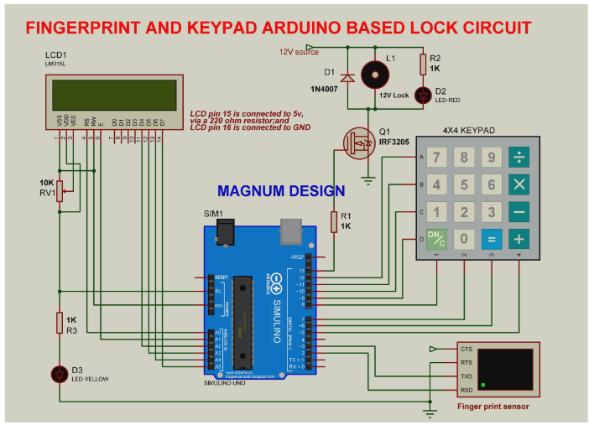
Appendix Block Diagram:

Slide 71
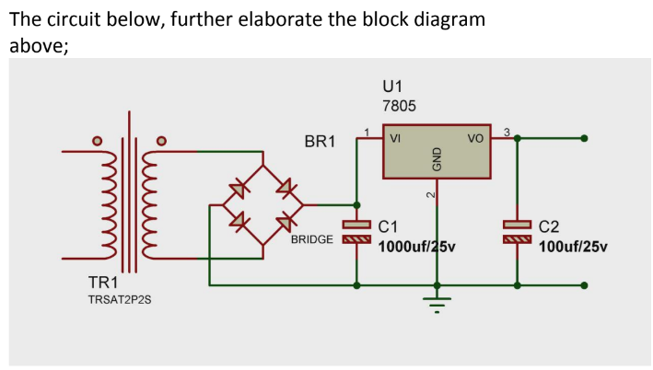
Appendix Circuit Diagram:

Slide 72
Thank You

